Slide 1
CTE
New Member
Self-Introduction
MXA DS TEAM
DATA SCIENCE INTERN ENGINEER
HAOCHEN YANG

Slide 2
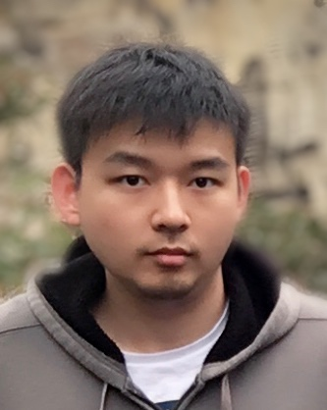
Who AM I ?
What I do ?
What is my hobby ?
What do you know about Micron ?
Or
Anything you want Team member to know

Slide 3
YANG HAOCHEN
Born in XI’AN
New Data Science Intern Engineer in MXA
Who AM I ?
Studying in The University of Sydney
Major in Electronic Engineering and Computer Science
Deep Learning, Image Classification
Research on Human Action Recognition with Domain Adaptation
2020 MASTER’S DEGREE (EXPECTED)
Graduated from The University of Melbourne
Major in Electric System
Embedded System
FPGA development
2017 BACHELOR’S DEGREE

Slide 4
What I do ?

Slide 5



What is my hobby ?
Basketball
Music
Cooking

Slide 6

What do you know about Micron ?
How do I know Micron?
Why do I choose Micron?
When I become a DS engineer, I want to do…

Slide 7
THANK YOU!

